Slide 1

Smarter Farm
Mid-Term Presentation
Darshak
Krithika
Saurabh
Shreya

Slide 2
Project Overview
Existing Problem
The development and dissemination of new technology is an important factor determining the future of agriculture.
The availability of human labor for agriculture is decreasing in an alarming rate. Also the pain of monitoring crops on a large-scale has to be handled with ease.
Hence, the introduction of technology in agriculture will lead to advancement in farming and also fascinate youngsters to take up this branch of study which is of utmost importance to cultivate crops and also increase the consumption of fresh and healthy food rather than packaged food.
Project Proposal
Our Solution :
We suggest a strategic decision-making precision toolkit to extend agriculture to new means, new places and new areas of the economy.
We propose the idea "Smarter Farm" – Mobile farm managing software!

Slide 3
STRATEGY
Product Objectives:
i)Business goals
To provide Safety and Security, Accessibility, Collaboration and Convenience.
To achieve higher crop productivity, lower costs on water and chemicals, reduced ecological impact, lower chemical runoff into water sources, increased worker safety, safer growing conditions and lower prices with the help of Technology.
Map, plan and monitor crops and equipment to farm more efficiently using GPS tracking
To monitor all farm activities under one roof and take farming to the next level!
ii)Success Metrics
Acquisition
Tracking no of installs
Cost per install
Engagement
Session length
Time in App
Popular Pages/Features
Retention
Retention Rate
Daily/Monthly active users
Monetisation
Average Revenue per User(ARPU)
Life-time Value(LTV)

Slide 4
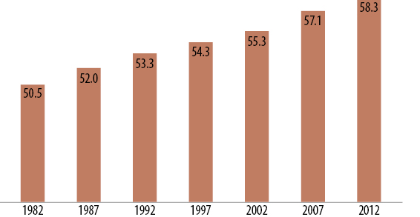
iii)User Analysis
In 2012, U.S. farmers were older and more diverse than in 2007, the last time the agriculture census was conducted. The total number of farmers declined, with the percentage decline more for women than men. More minorities operated farms in 2012, and the number of beginning farmers declined.

Slide 5
Scope plane-Functional Specifications
View all information about all batches of fields
Display location of the field using maps
Visually check the growth of plants through Virtual Reality
Post and share articles on gardening or any information to be shared
Search functionality for different fields, agrobots, sprinklers
Check the status of all sprinklers if they are malfunctioning
Add features like google voice
Post and share articles on gardening or any information to be shared
Send alerts over SMS/ Email if any parameters are below threshold

Slide 6
Scope Plane-Content Requirements
Having drone recording all the activities taking place in the farm in the form of videos and photos
Sensor data is an important requirement needed to do all the analysis
Priority Requirement: Continuous monitoring of the field and data from sensors is essential
Social Networking between farmers from different regions and languages
Internalization support to connect farmers from varied regions and different locales
Buying of smart equipment and building solutions for a smarter farm through the website

Slide 7
User Research Outcomes
Usability and User Research
Language preference, voice recognition, single page website, advanced search(based on categories/auto complete), user-friendly/easy vision menu
Market Research Methods-Surveys/Questionnaires/Card sorting
Creating Personas

Slide 8
SITE ACCESSIBILITY
The W3C Web Accessibility Initiative (WAI) brings together people from industry, disability organizations, government, and research labs from around the world to develop guidelines and resources to help make the Web accessible to people with disabilities including auditory, cognitive, neurological, physical, speech, and visual disabilities.
Visually Impaired
Enlarged Text
Contrast is Key
Mindful colors for action items
App like web design
Keyboard shortcuts for navigation
Hearing Impaired
Podcasts

